Slide 1
Project : Renovation of Male Washroom (near the DOII)
Project Type: Faculty Facelift Projects
Project Number: 35
Committed Donors : E/76 Batch

Slide 2
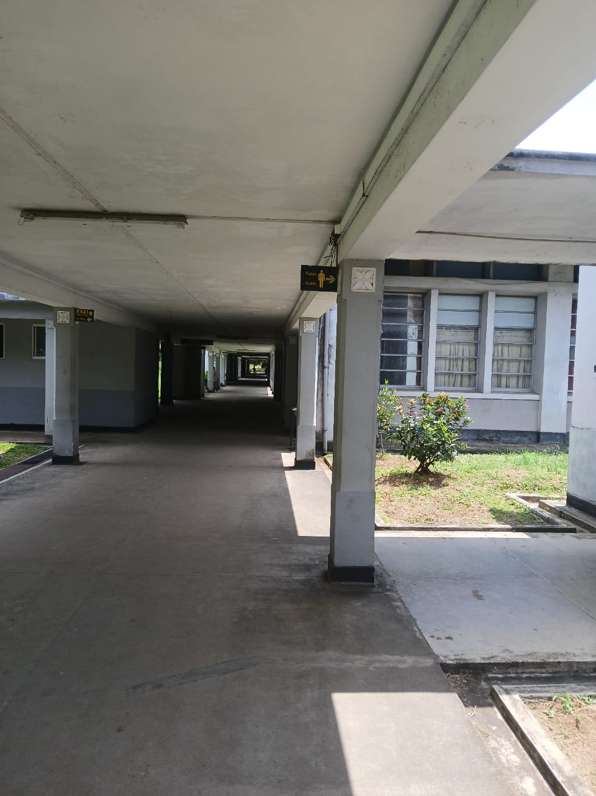
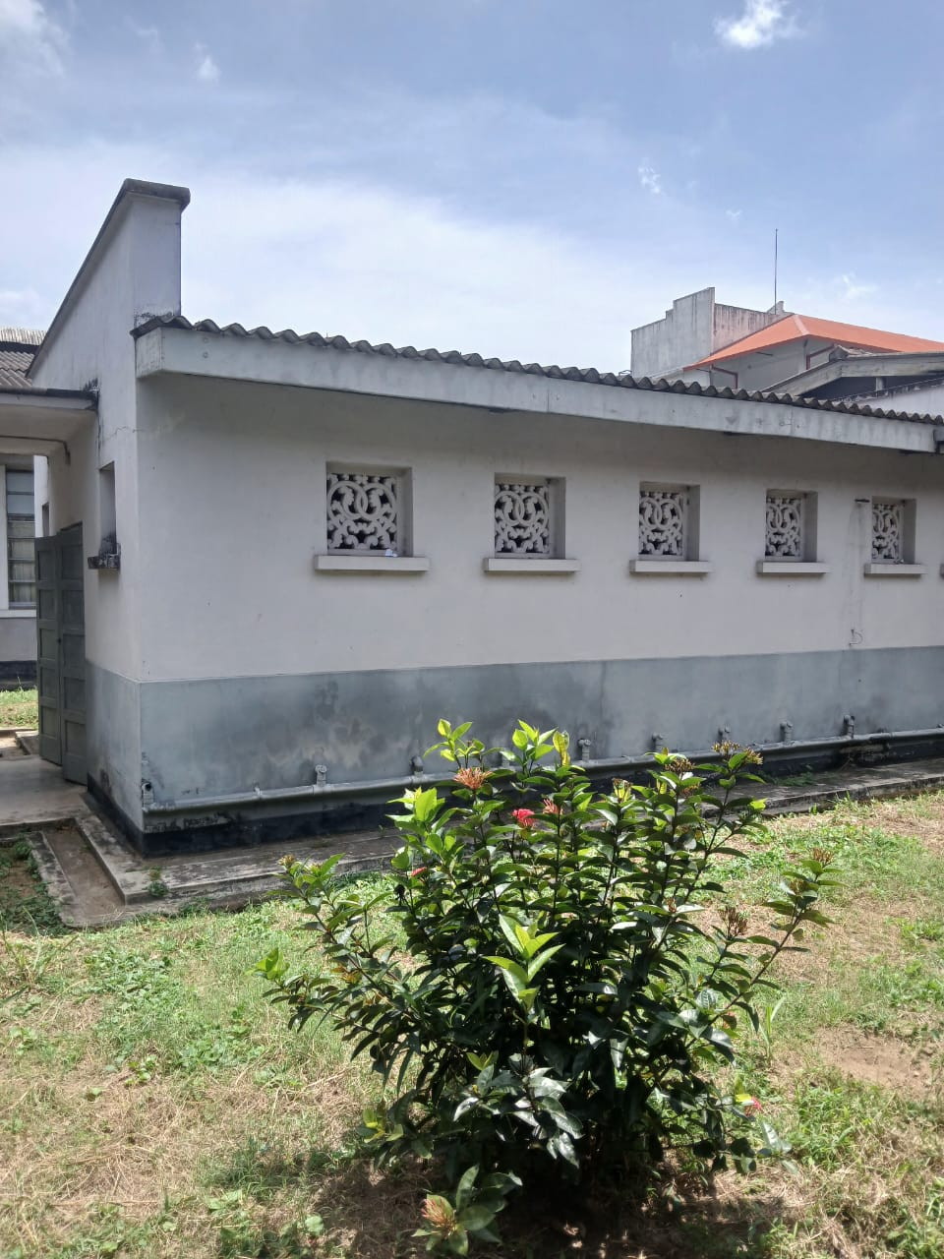
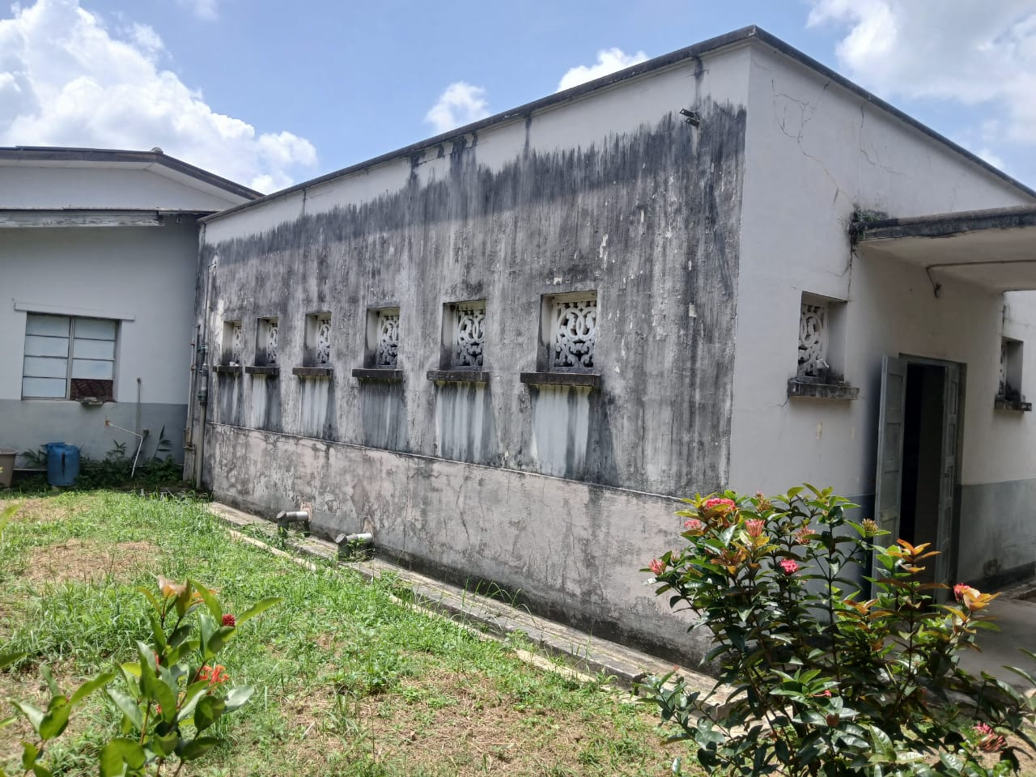
Proposed Location

Slide 3
Proposed Renovations for the Washroom

Slide 4
Estimated Budget
Serial No. | Required Item | Unit | Quantity | Rate | Amount
1 | Supply and Installation of model EFI Pedestal Wash basin | Nos. | 1 | 32,500.00 | 32,500.00
2 | Supply and Installation of Squatting Pan | Nos. | 2 | 25,000.00 | 50,000.00
3 | Supply and Installation of Flushing tank | Nos. | 2 | 15,000.00 | 30,000.00
4 | Supply and Installation of the door for disable toilet | Nos. | 1 | 20,000.00 | 20,000.00
5 | Supply and Installation of SD90943L Cold Water Tap | Nos. | 5 | 15,000.00 | 75,000.00
6 | Supply and Installation of model A603 Angle valves | Nos. | 8 | 2,500.00 | 20,000.00
7 | Supply and Installation of model SD9A126 Rocell Wall Mounted Tap | Nos. | 6 | 9,000.00 | 54,000.00
8 | Supply and installation of a shower set | Nos. | 1 | 18,000.00 | 18,000.00
9 | Supply and installation of 300mm x 300 mm floor tiles of approved color. | SQ Ft | 200 | 400.00 | 80,000.00
10 | Supply and installation of 600mm * 300mm wall tiles of approved color. | SQ Ft | 200 | 425.00 | 85,000.00
11 | 500mm x 700mm Rectangular, beveled edge wall-mounted mirror - (Model FLM 5) 4mm Thickness | Nos. | 5 | 15,000.00 | 75,000.00
12 | Framed mirror (1200mm * 600mm) | Nos. | 2 | 20,000.00 | 40,000.00
13 | Supply and Installation of Pedal Dustbin | Nos. | 2 | 2,000.00 | 4,000.00
14 | Supply and Installation of Wooden Detergent Rack | Nos. | 2 | 5,000.00 | 10,000.00

Slide 5
Estimated Budget Cont..
15 | Supply and Installation of 5W LED Bulb/ 2ft fluorescent lamps | Nos. | 4 | 3,000.00 | 12,000.00
16 | Supply and Installation of Bag Racks | Nos. | 2 | 7,500.00 | 15,000.00
17 | Supply and Installation of IDC-A0222 Soap Wire Basket | Nos. | 5 | 15,000.00 | 75,000.00
18 | Supply and Installation of Model IDC-A0308 Paper Holder | Nos. | 5 | 8,000.00 | 40,000.00
19 | Supply and Installation of SCL 01 Chrome Metal Flex Bidet Spray | Nos. | 5 | 10,000.00 | 50,000.00
20 | Supply and installation of sensor taps for the urinals | Nos. | 9 | 40,000.00 | 360,000.00
21 | Bag Hanger inside wash room | Nos. | 3 | 3,000.00 | 9,000.00
22 | Supply of uPVC pipes and specials valves | Item |  |  | 50,000.00
23 | Installation cost of additional uPVC Pipes, Specials and Valves | Item |  |  | 25,000.00
24 | Allow for removal of sanitary fittings and tiles etc. | Item |  |  | 25,000.00
25 | Internal painting of the washroom block 2 (near DO2) | Sq ft | 1120 | 98.00 | 109,760.00
26 | Supply and installation of a main door lock plus painting the door | Item |  |  | 15,000.00
27 | Allow for valance board, uPVC gutter and down pipes | Item |  |  | 42,000.00
28 | Allow for removal of sanitary fittings and tiles etc. | Item |  |  | 60,000.00
 | Sub Total |  |  |  | 1,421,260.00

Slide 6
Suggested Additional Items
Required Item | Quantity | Cost per one (Rs.) | Total Cost (Rs.)
Cleaning the tiles with top quaity cleaners | Allow |  | 50,000.00
Hand Dryer | 8 | 30,000.00 | 240,000.00
Handwash Dispenser | 8 | 5,000.00 | 40,000.00
Paper Towel Dispenser | 8 | 6,000.00 | 48,000.00
Indoor Plants | 30 | 250.00 | 7,500.00
Total |  |  | 385,500.00

Slide 7
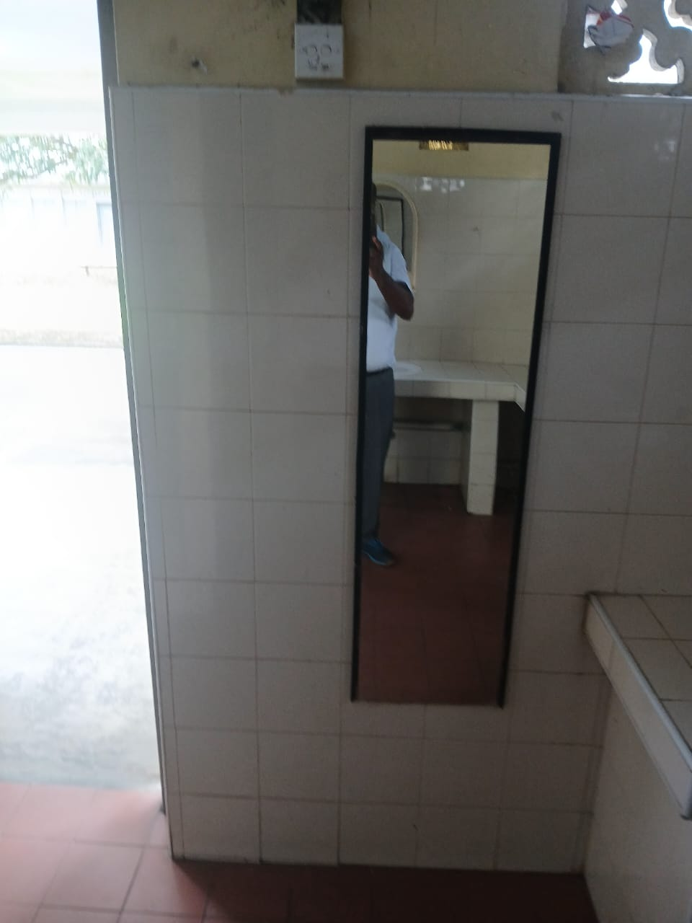
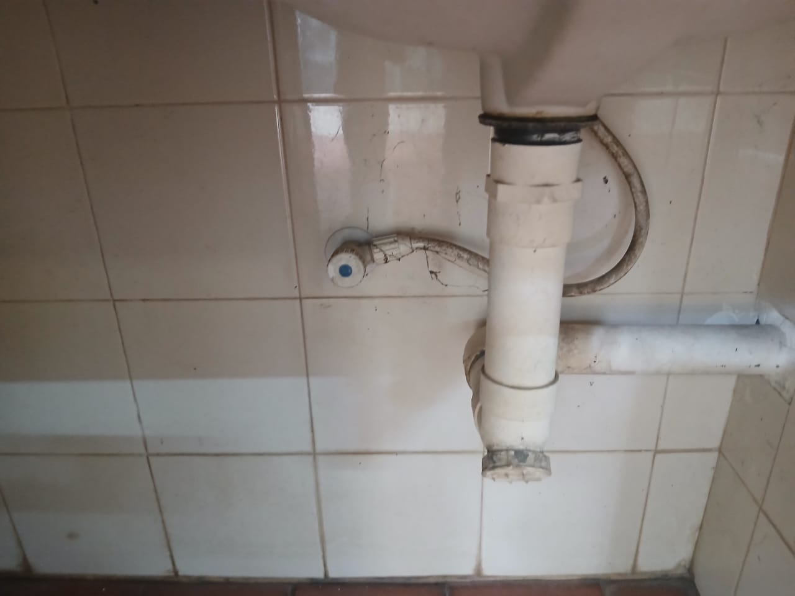
Current situation of the Washroom

Slide 8
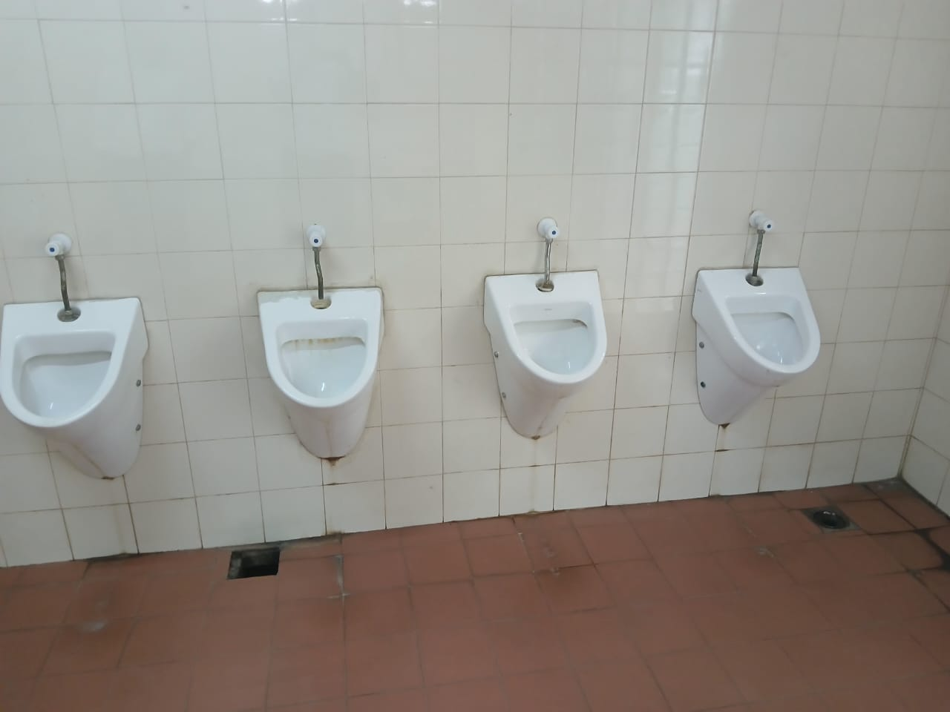
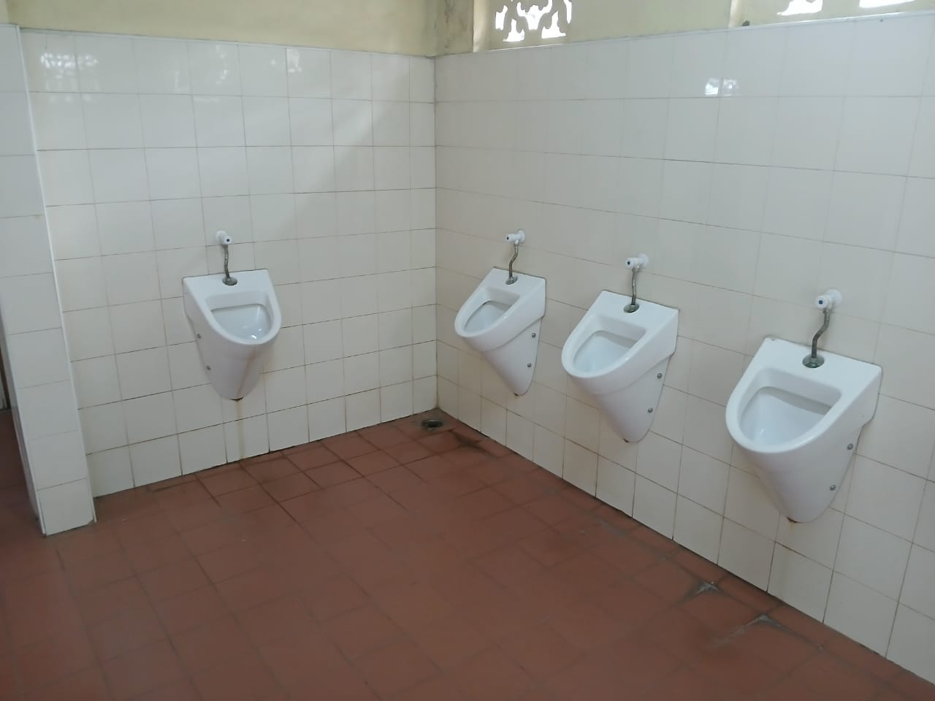
Current situation of the Washroom Cont..

Slide 9
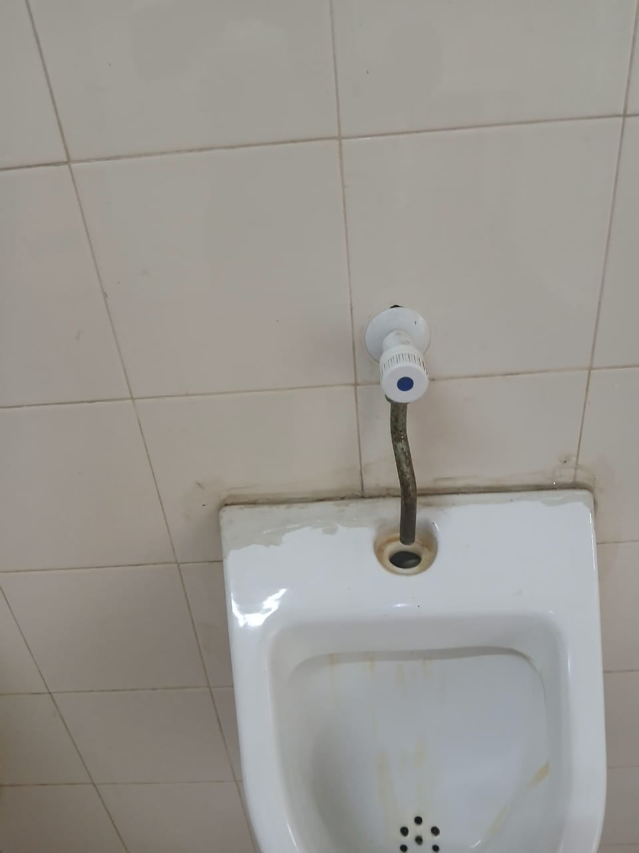
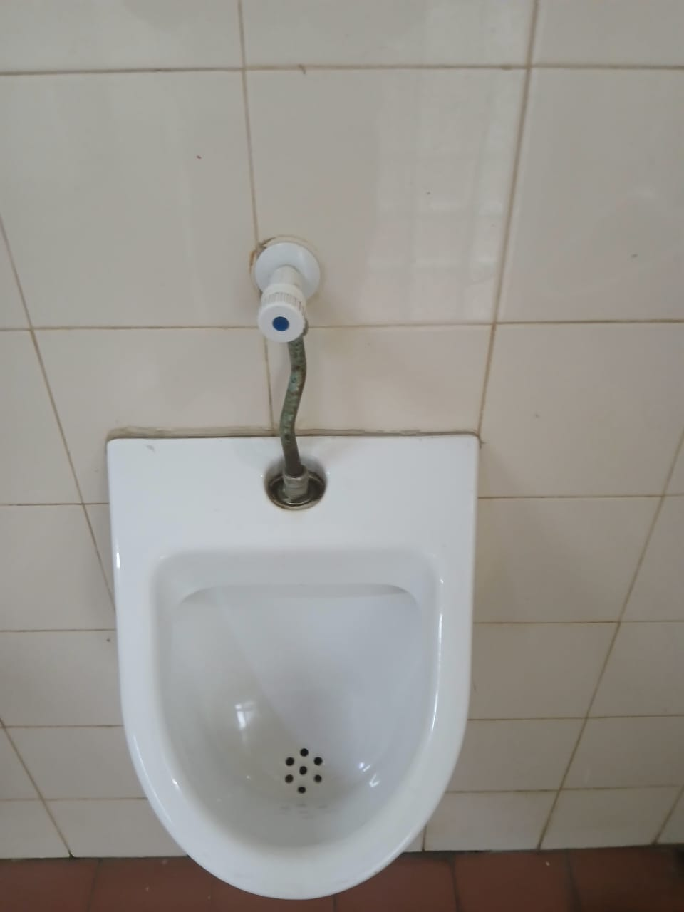
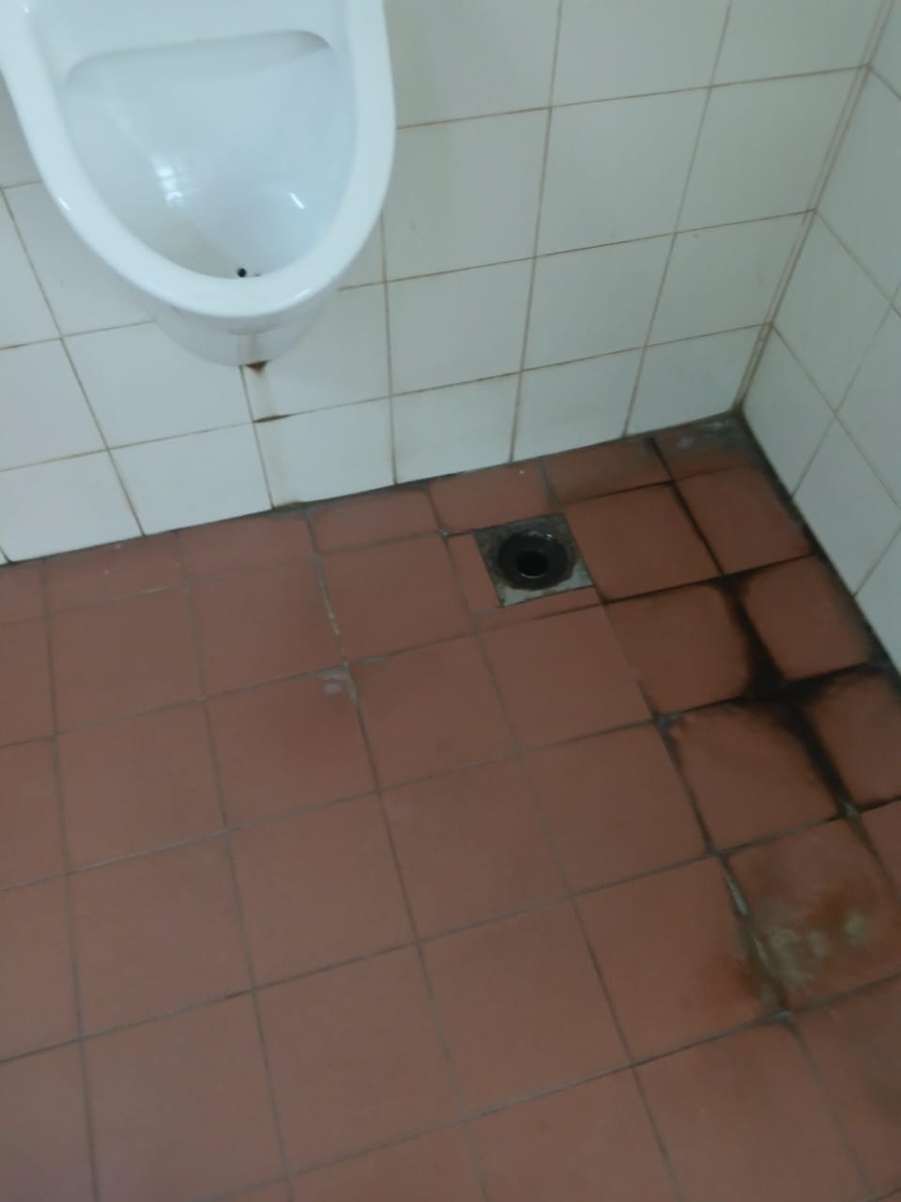
Current situation of the Washroom Cont..

Slide 10
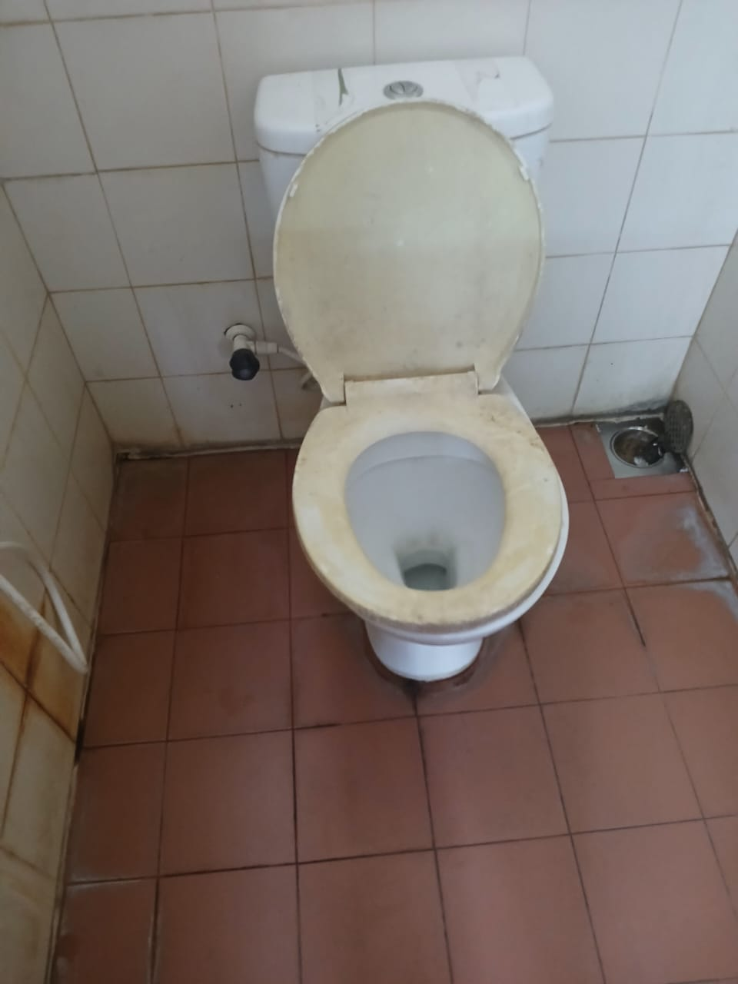
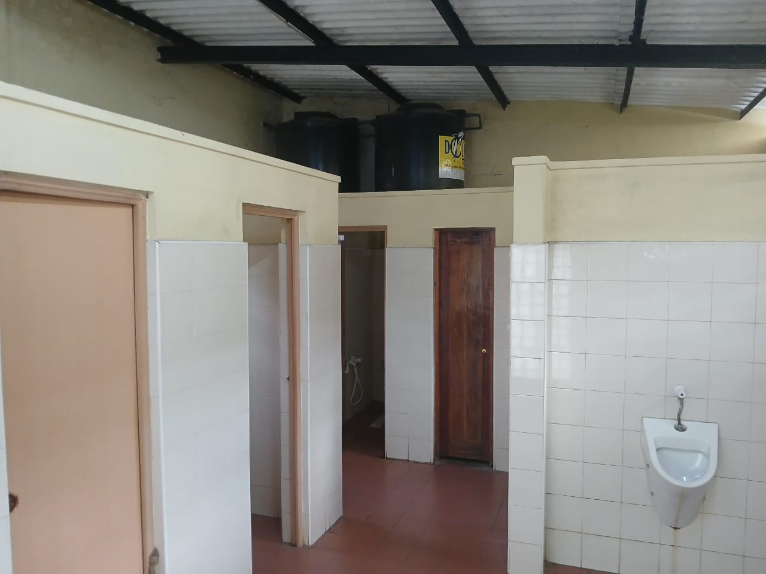
Current situation of the Washroom Cont..

Slide 11
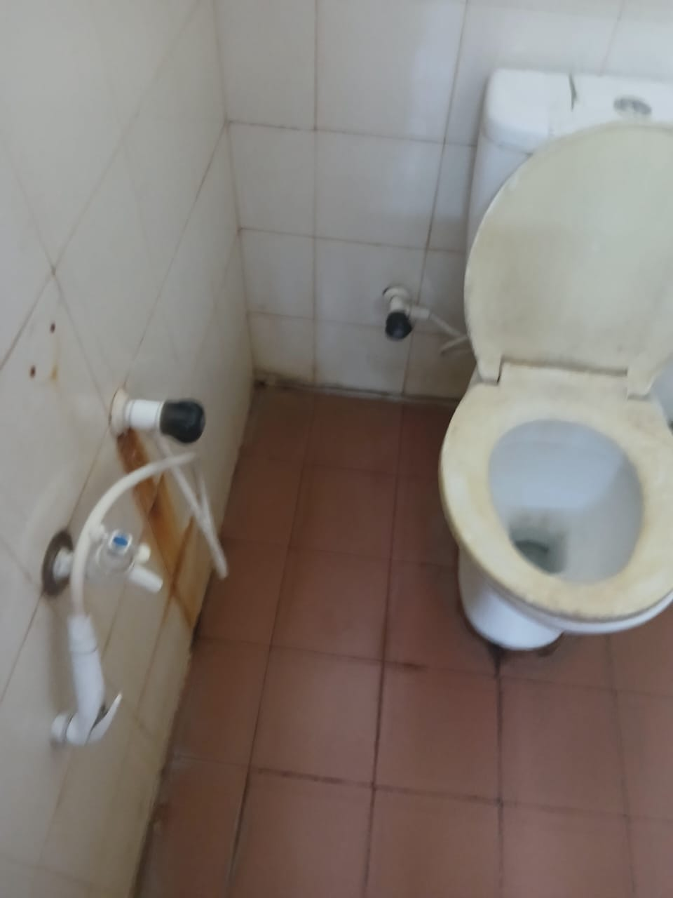
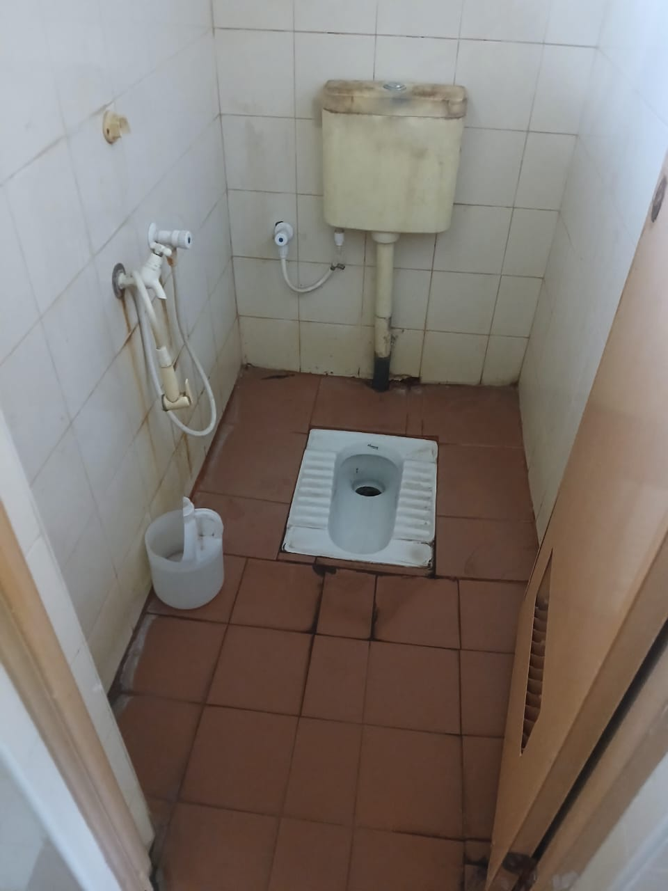
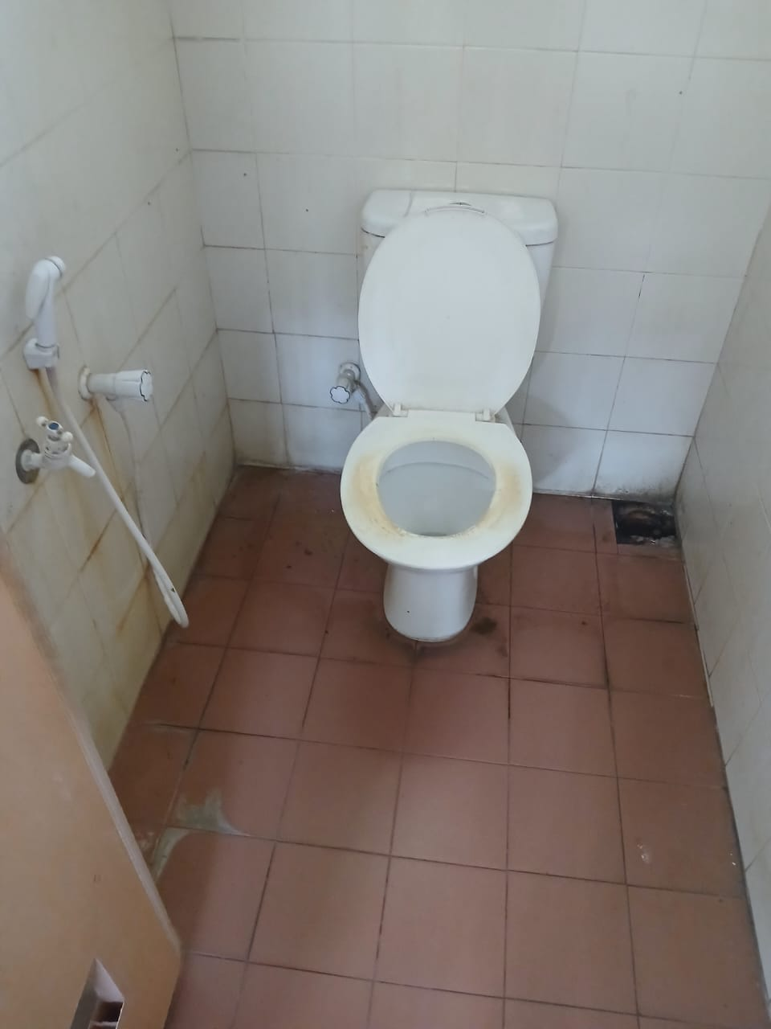
Current situation of the Washroom Cont..

Slide 12
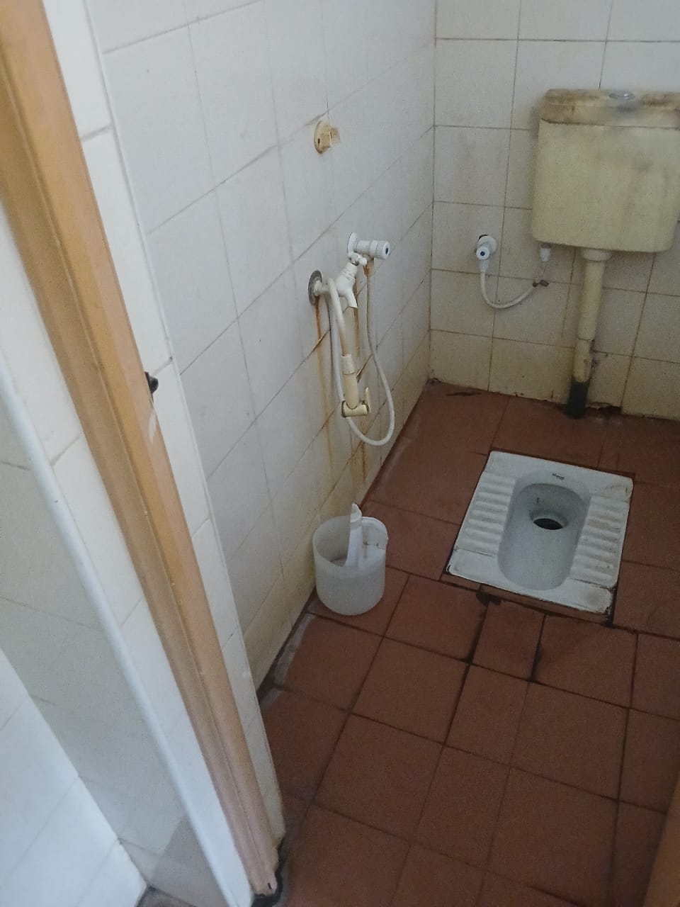
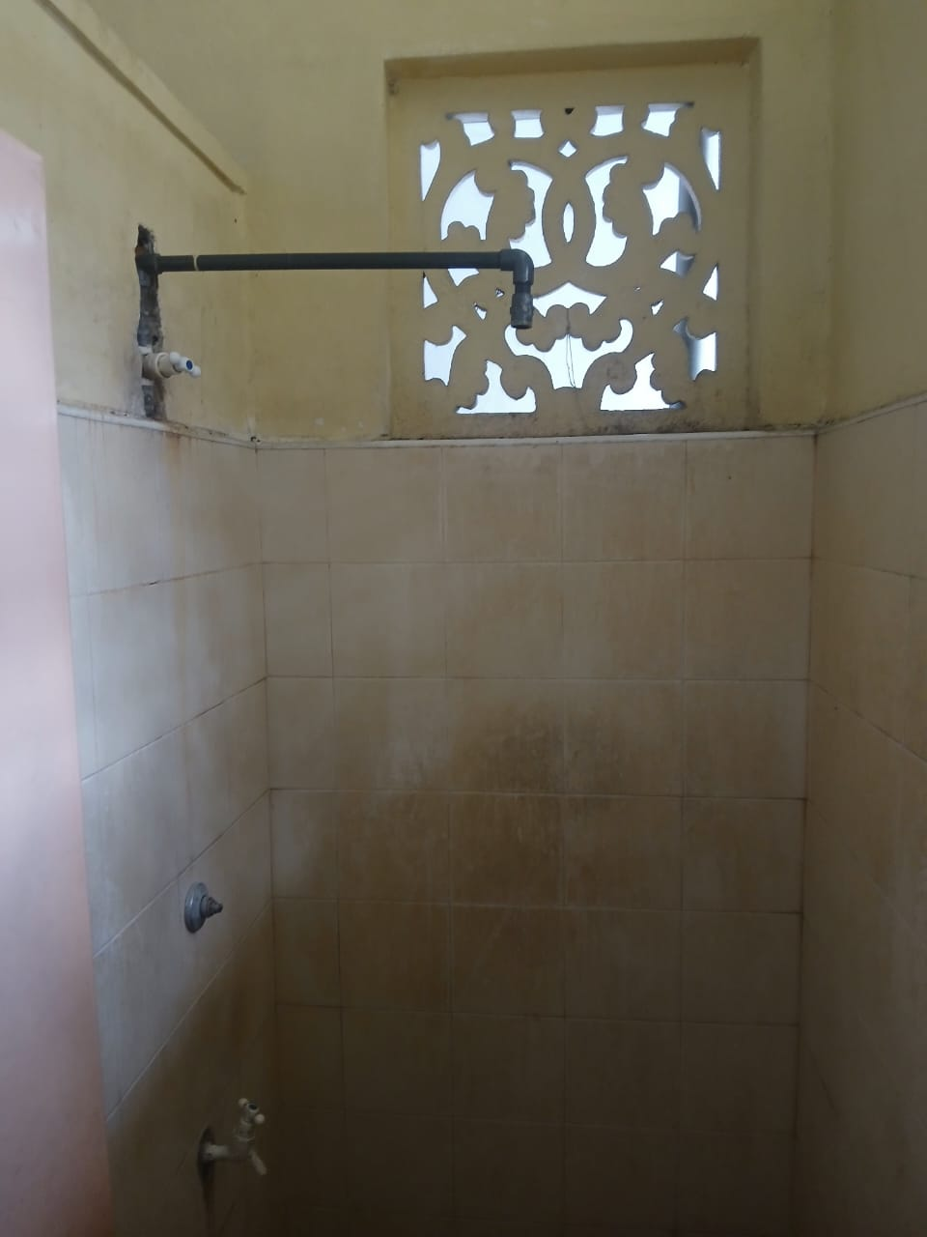
Current situation of the Washroom Cont..

Slide 13
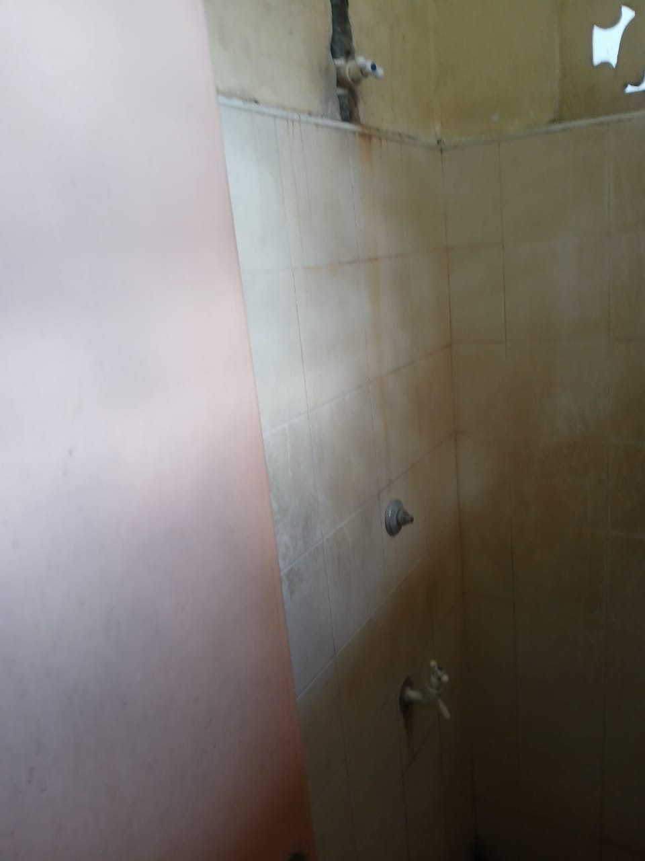
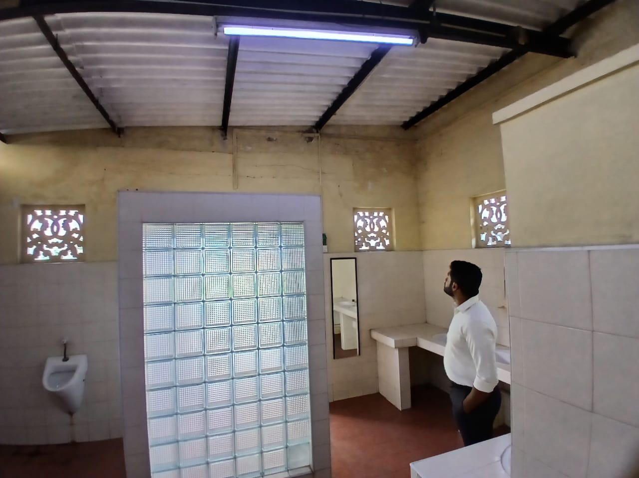
Current situation of the Washroom Cont..

Slide 14
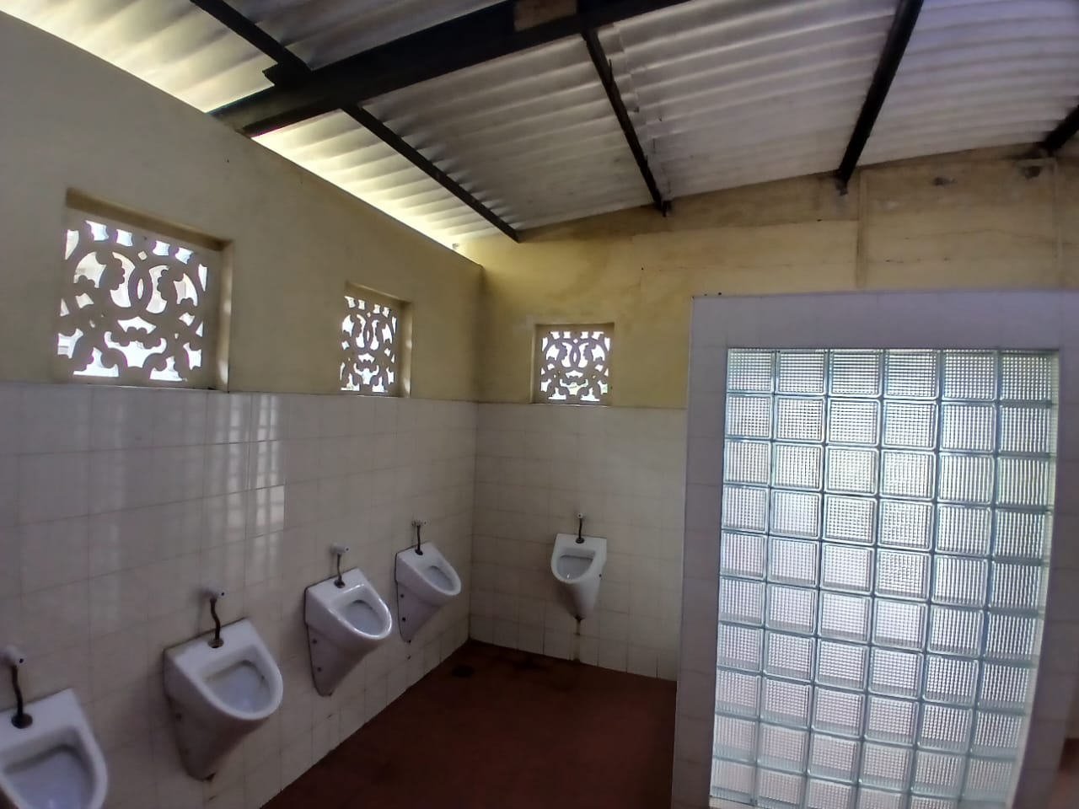
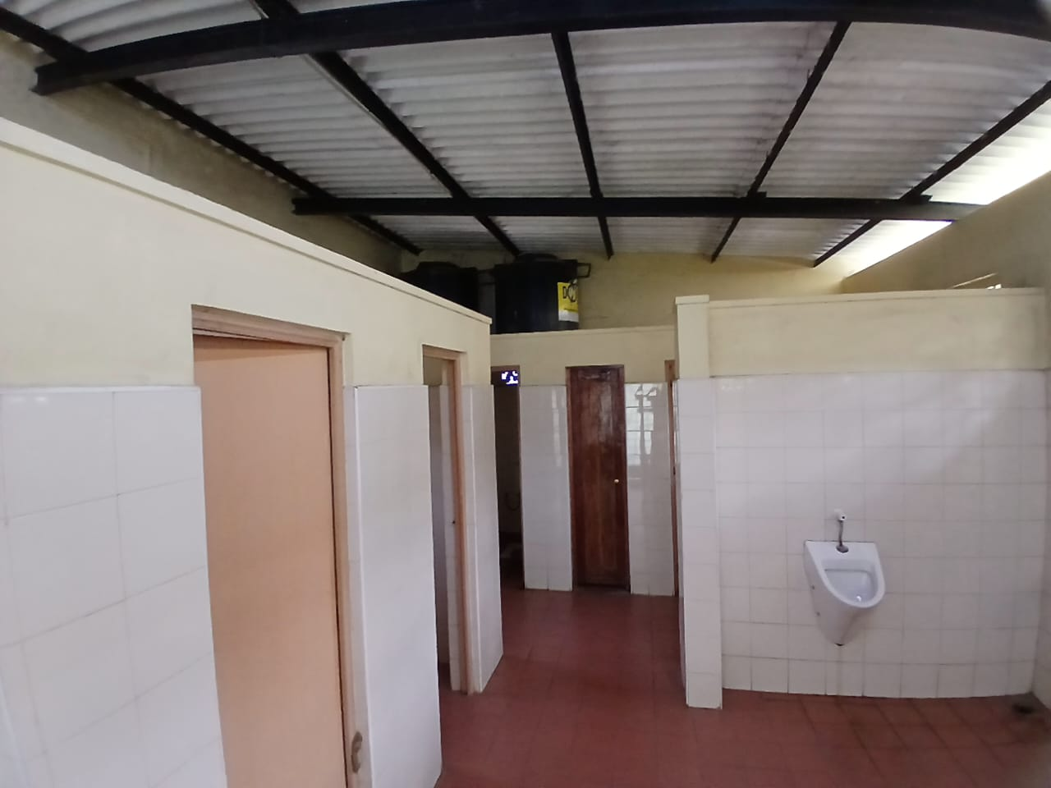
Current situation of the Washroom Cont..

Slide 15
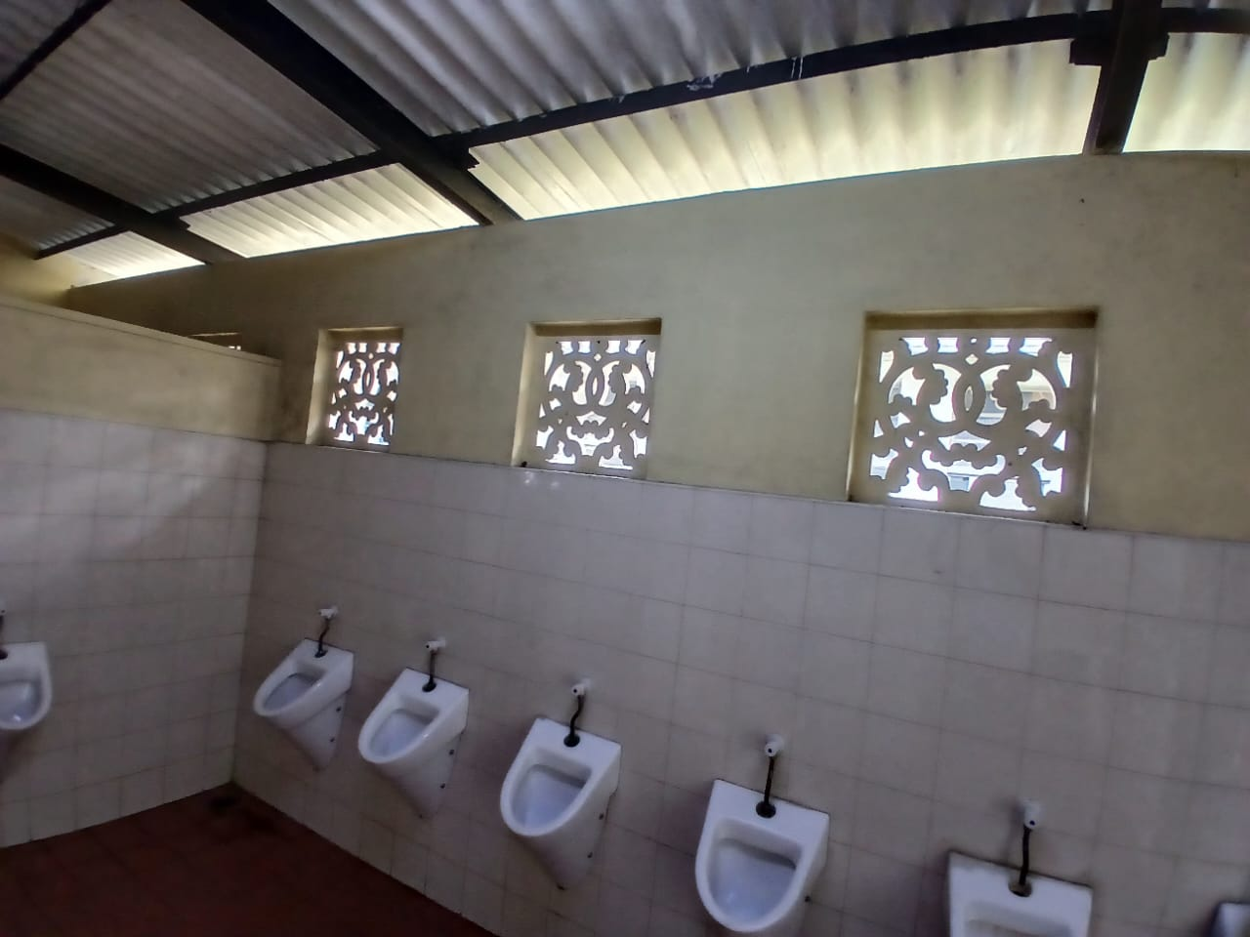
Current situation of the Washroom Cont..

