Slide 1
Project : Renovation of Male Washroom (near the Lecture room 09)
Project Type: Faculty Facelift Projects
Project Number: 35
Committed Donors : E/76 Batch

Slide 2
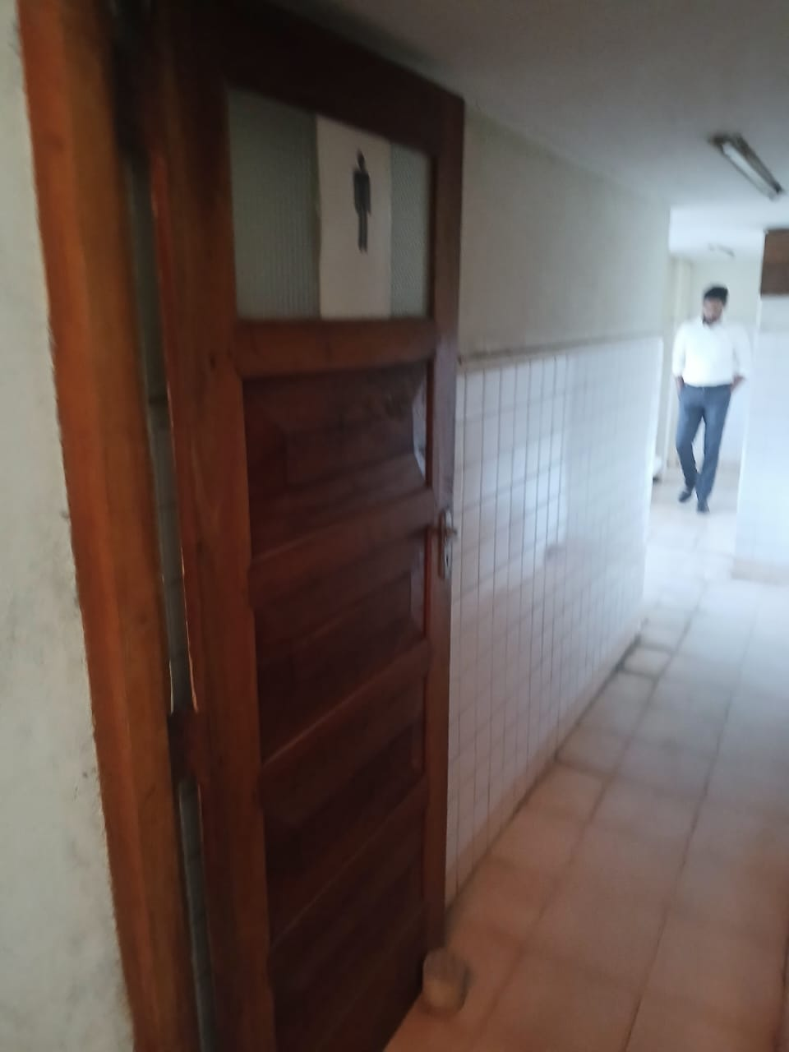
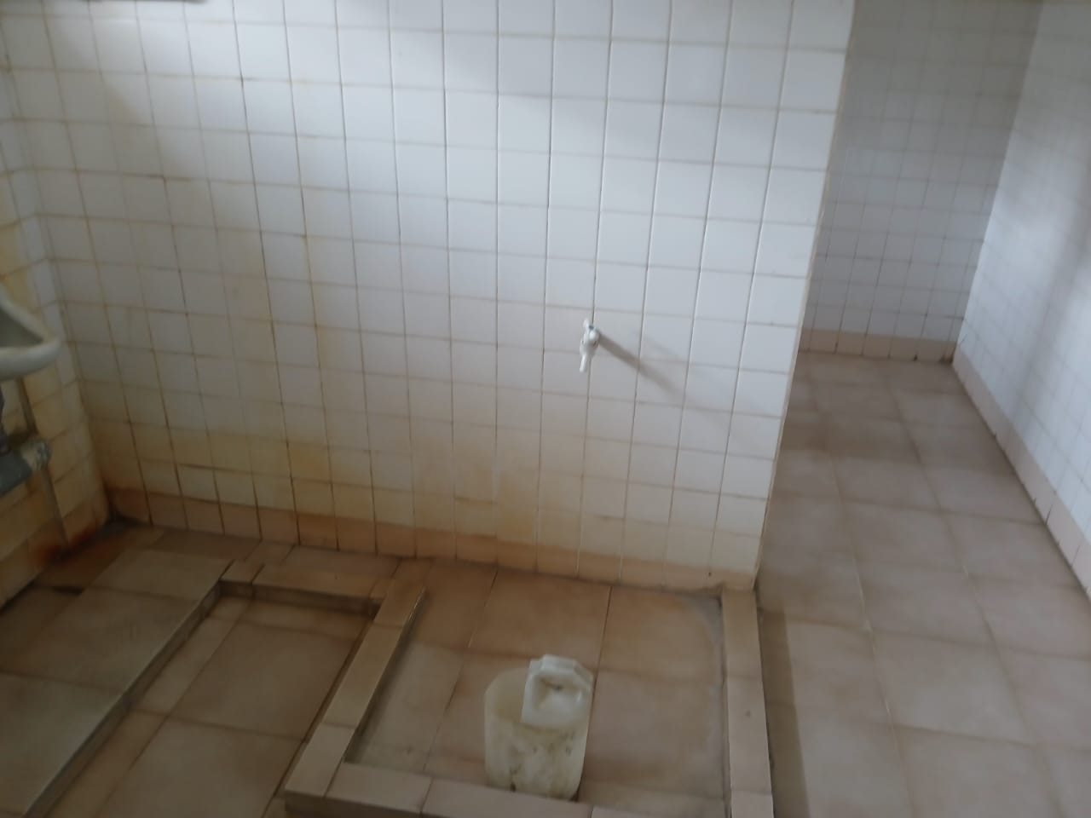
Proposed Location

Slide 3
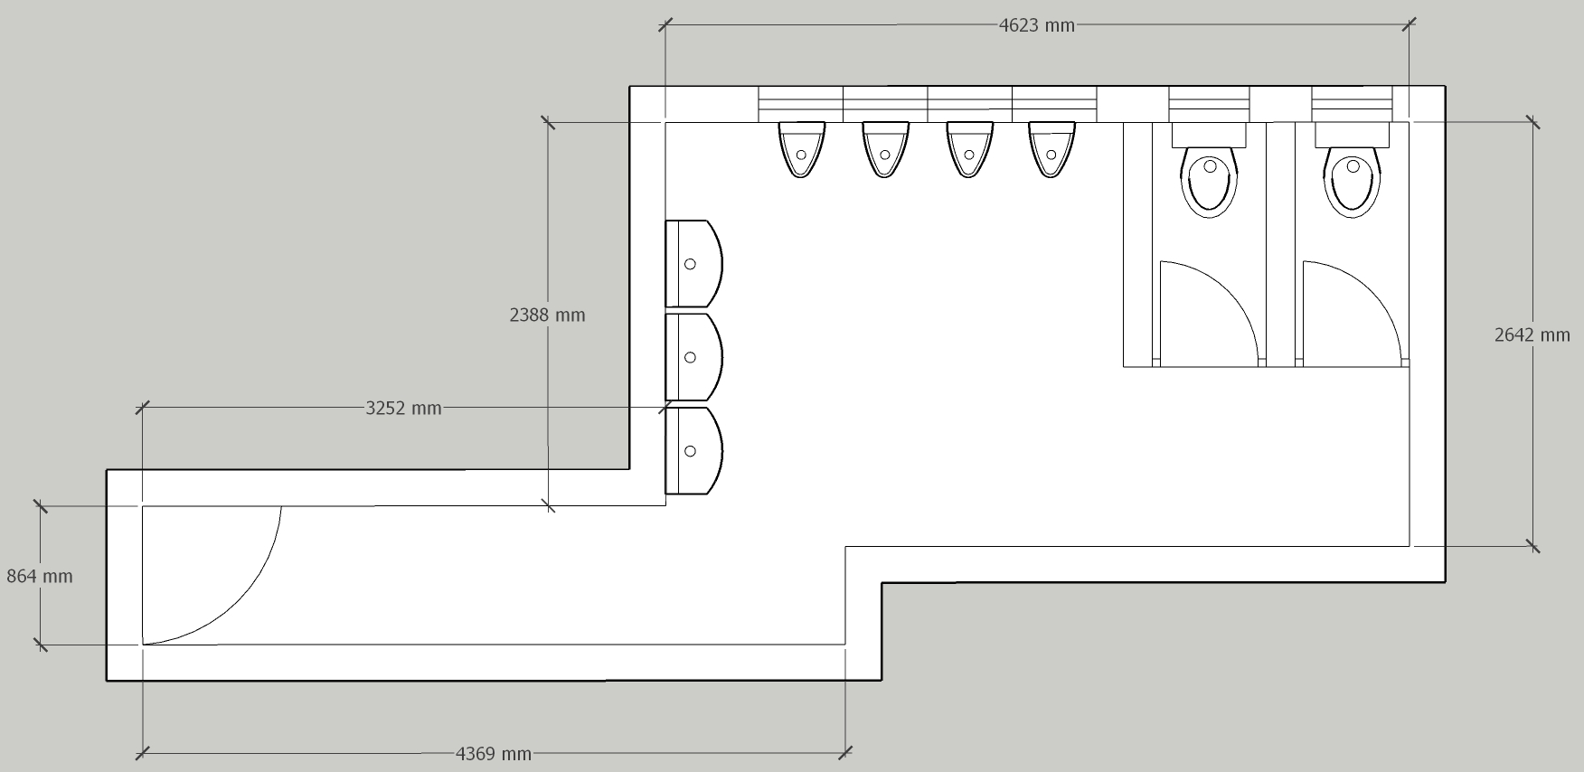
Proposed Renovations for the Washroom

Slide 4
Estimated Budget
Serial No. | Required Item | Unit | Quantity | Rate | Amount
1 | Supply and Installation of model EFI Pedestal Wash basin | Nos. | 3 | 32,500.00 | 97,500.00
2 | Supply and Installation of model EFI Water Closet | Nos. | 2 | 50,000.00 | 100,000.00
4 | Supply and Installation of Urinals with sensor taps | Nos. | 4 | 75,000.00 | 300,000.00
6 | Supply and Installation of SD90943L Cold Water Tap | Nos. | 3 | 15,000.00 | 45,000.00
7 | Supply and Installation of model A603 Angle valves | Nos. | 8 | 2,500.00 | 20,000.00
8 | Supply and Installation of model SD9A126 Rocell Wall Mounted Tap | Nos. | 3 | 9,000.00 | 27,000.00
9 | Supply and installation of 300mm x 300 mm floor tiles of approved color. | SQ Ft | 200 | 400.00 | 80,000.00
10 | Supply and installation of 600mm * 300mm wall tiles of approved color. | SQ Ft | 200 | 425.00 | 85,000.00
11 | 500mm x 700mm Rectangular, beveled edge wall-mounted mirror - (Model FLM 5) 4mm Thickness | Nos. | 3 | 15,000.00 | 45,000.00
12 | Framed mirror (1200mm * 600mm) | Nos. | 1 | 20,000.00 | 20,000.00
13 | Supply and Installation of Pedal Dustbin | Nos. | 2 | 2,000.00 | 4,000.00
14 | Supply and Installation of Wooden Detergent Rack | Nos. | 2 | 5,000.00 | 10,000.00

Slide 5
Estimated Budget Cont..
15 | Supply and Installation of 5W LED Bulb/ 2ft fluorescent lamps | Nos. | 3 | 3,000.00 | 9,000.00
16 | Supply and Installation of Bag Racks | Nos. | 2 | 7,500.00 | 15,000.00
17 | Supply and Installation of IDC-A0222 Soap Wire Basket | Nos. | 2 | 15,000.00 | 30,000.00
18 | Supply and Installation of Model IDC-A0308 Paper Holder | Nos. | 2 | 8,000.00 | 16,000.00
19 | Supply and Installation of SCL 01 Chrome Metal Flex Bidet Spray | Nos. | 2 | 10,000.00 | 20,000.00
21 | Bag Hanger inside wash room | Nos. | 3 | 3,000.00 | 9,000.00
22 | Supply of uPVC pipes and specials valves | Ttem |  |  | 75,000.00
23 | Installation cost of additional uPVC Pipes, Specials and Valves | Item |  |  | 40,000.00
24 | Allow for removal of sanitary fittings and tiles etc. | Item |  |  | 30,000.00
25 | Internal painting of the washroom block 2 (near DO2) | Sq ft | 600 | 98.00 | 58,800.00
 | Sub Total |  |  |  | 1,136,300.00

Slide 6
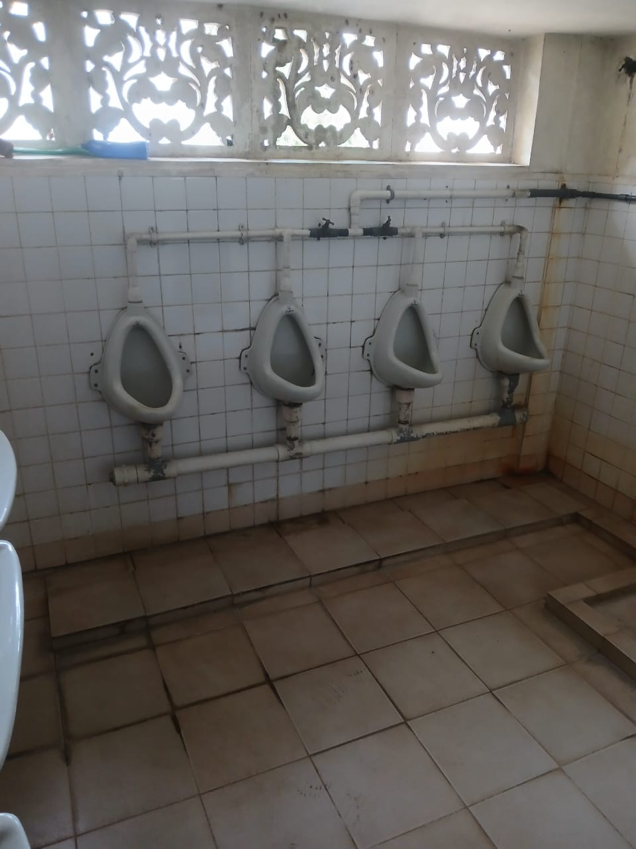
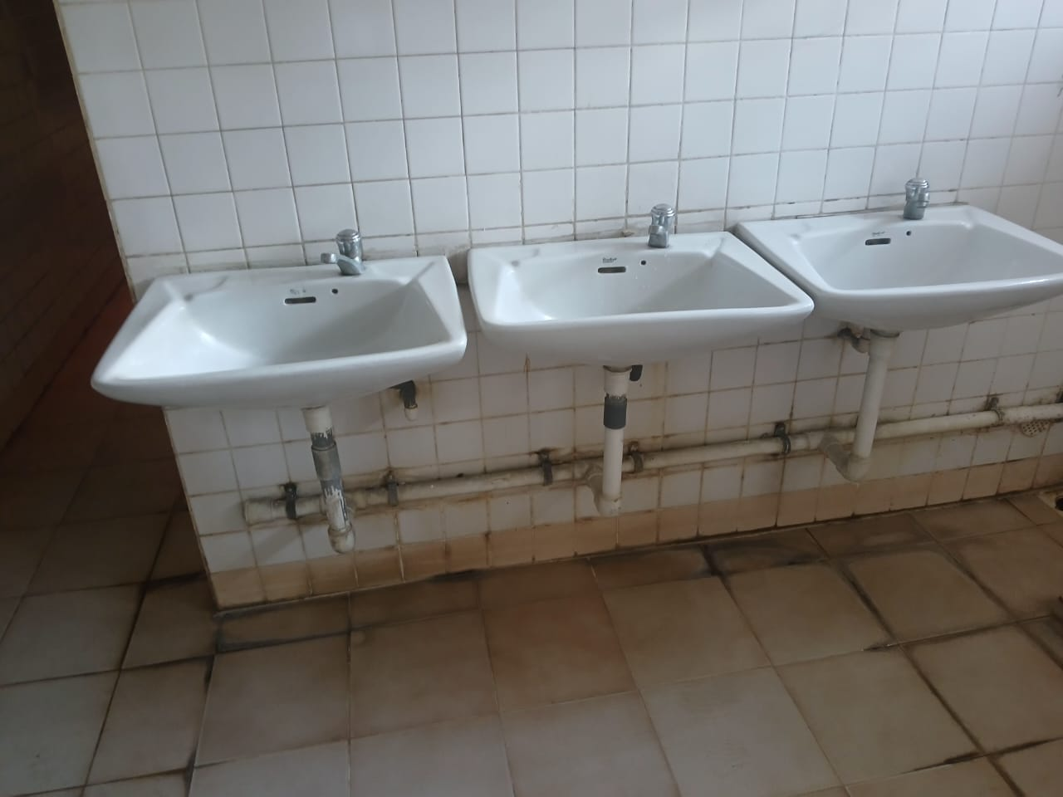
Current situation of the Washroom

Slide 7
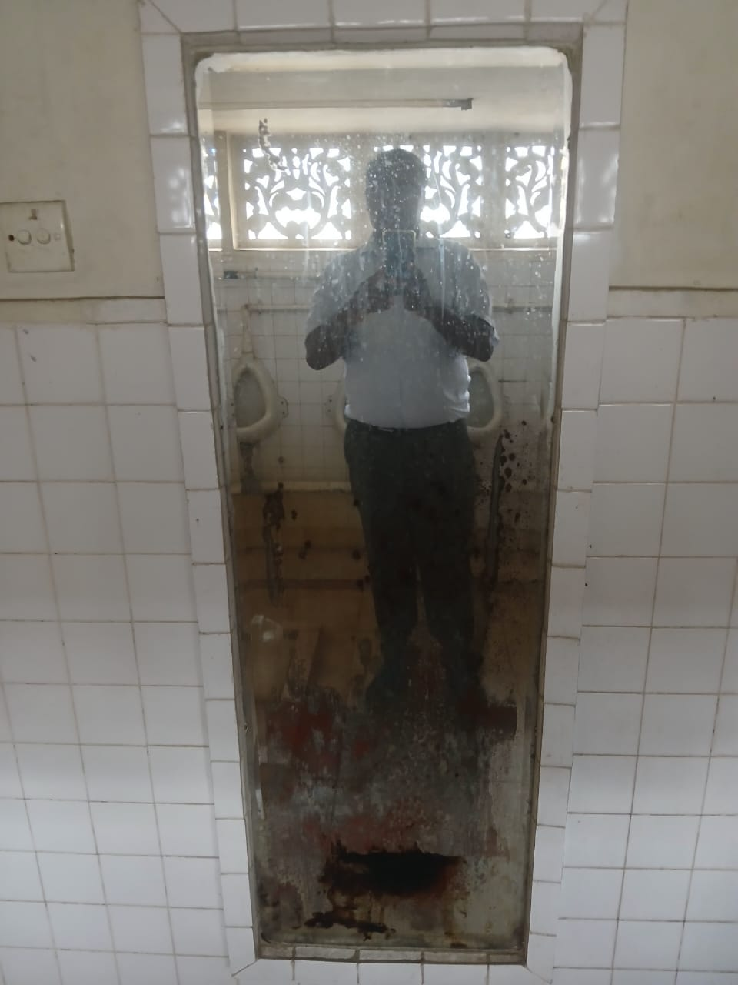
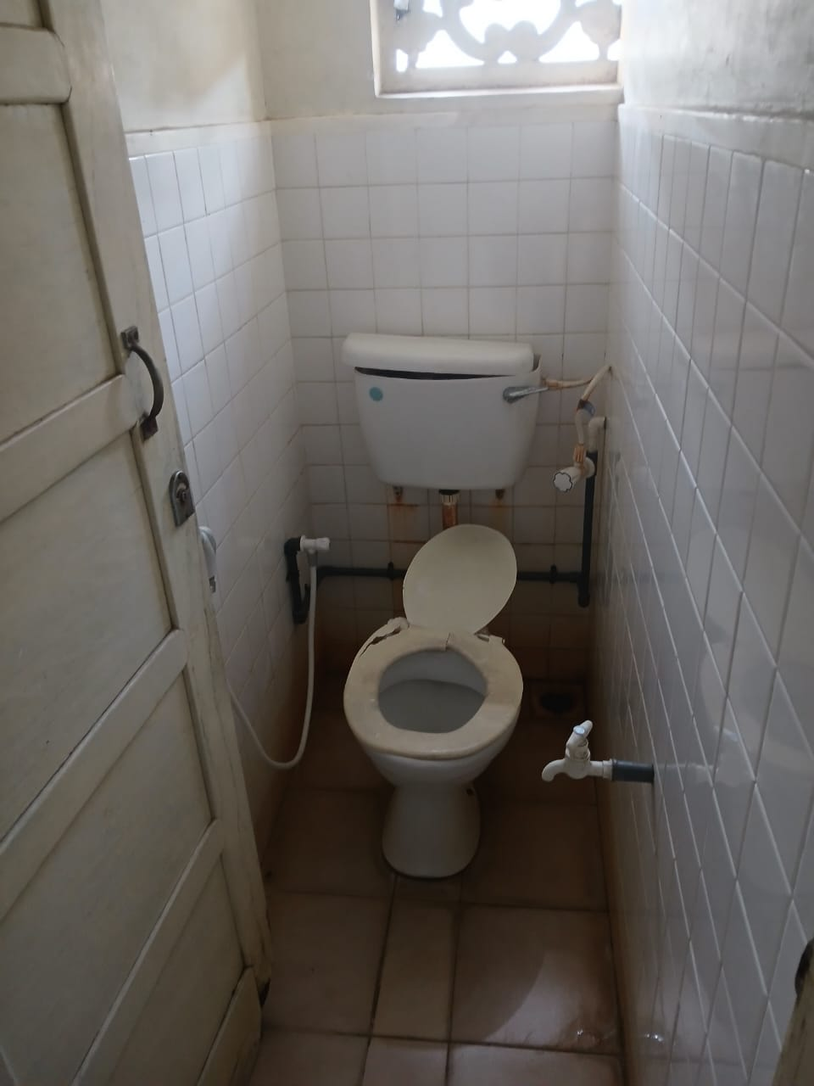
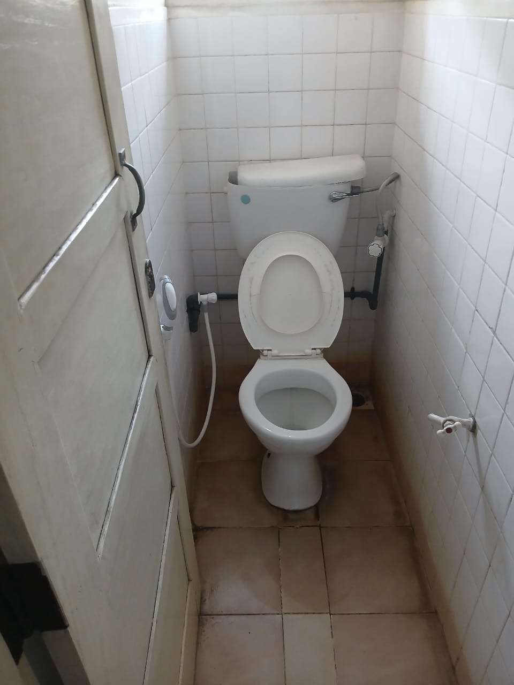
Current situation of the Washroom Cont..

